Slide 1

Project 3 -UFO Sightings in Australia
Luz, Trong, Stephen and Kirsty

Slide 2
Project Outline
Project theme
Data wrangling techniques
Coding approach
Final visualisation

Slide 3

Project Objective
Produce a dashboard page that displays multiple charts and has user-driven interactions

Slide 4
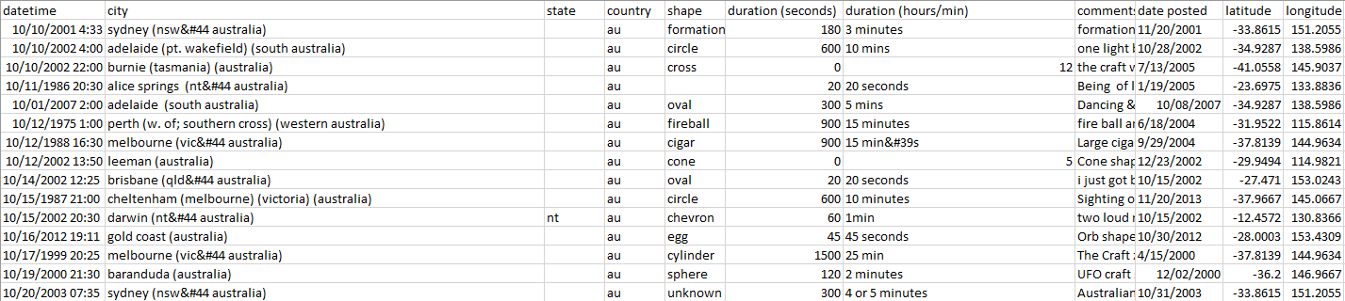

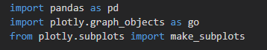
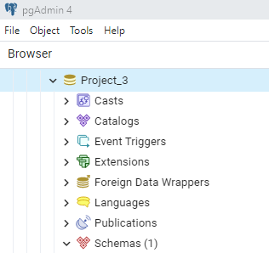
Data wrangling
Dataset:

Slide 5
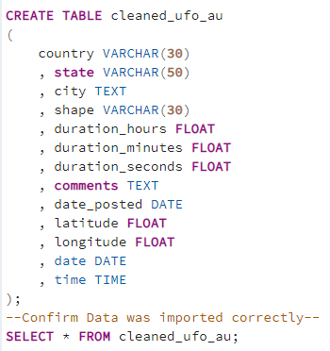
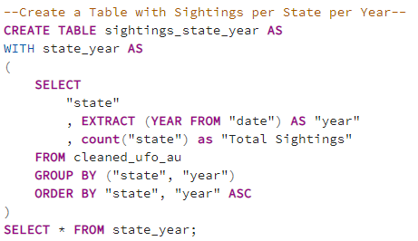
Data wrangling
Challenges:
State: Missing Info
Duration: Strings and numbers mixed
Database SQL:
Notes:
Steps taken:
Data review and inspection – quality/structural errors/values
Review of quality, missing values, data types, column names
Formatting, dropping of columns Data cleaning steps taken
Data Validation:
Does the data make sense?
Does the data follow the appropriate rules for its field?
Does it prove or disprove your working theory, or bring any insight to light?
Can you find trends in the data to help you form your next theory?
What is data cleaning?
Data cleaning is the process of fixing or removing incorrect, corrupted, incorrectly formatted, duplicate, or incomplete data within a dataset. When combining multiple data sources, there are many opportunities for data to be duplicated or mis-labeled. If data is incorrect, outcomes and algorithms are unreliable, even though they may look correct. There is no one absolute way to prescribe the exact steps in the data cleaning process because the processes will vary from dataset to dataset. But it is crucial to establish a template for your data cleaning process so you know you are doing it the right way every time.
What is the difference between data cleaning and data transformation?
Data cleaning is the process that removes data that does not belong in your dataset. Data transformation is the process of converting data from one format or structure into another. Transformation processes can also be referred to as data wrangling, or data munging, transforming and mapping data from one "raw" data form into another format for warehousing and analyzing. This article focuses on the processes of cleaning that data.
Validate
At the end of the data cleaning process, you should be able to answer these questions as a part of basic validation:
Does the data make sense?
Does the data follow the appropriate rules for its field?
Does it prove or disprove your working theory, or bring any insight to light?
Can you find trends in the data to help you form your next theory?
If not, is that because of a data quality issue?

Slide 6

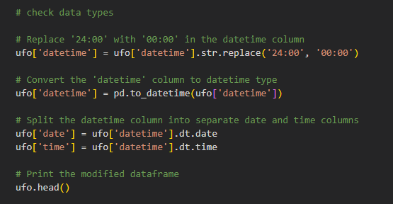
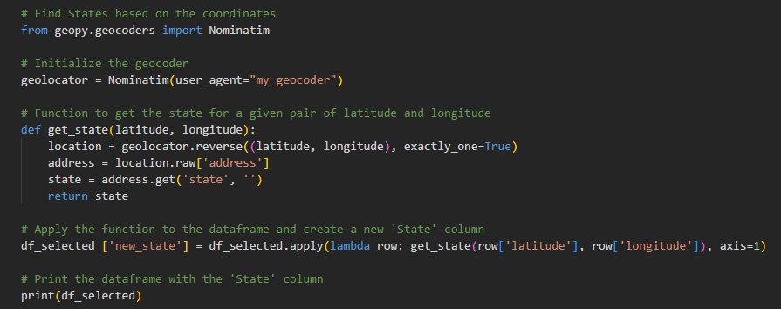
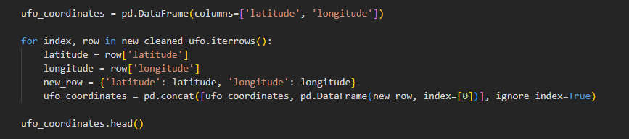
Data wrangling
Pandas:

Slide 7
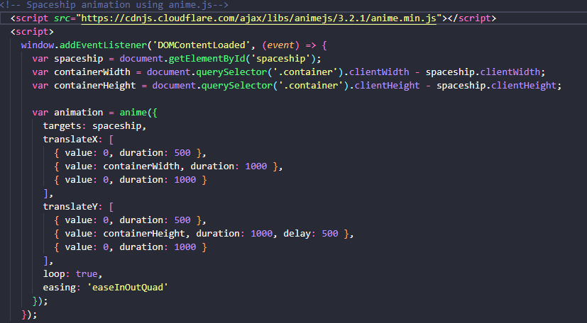
Front End
Page layout with links to the visualizations.
Using Anime.js to animate a flying UFO

Slide 8

Visualisations
Wordcloud
Interactive heat map displaying UFO sightings across Australia
Line graph showcasing the trends of UFO sightings across the years and states
Distribution of UFO shapes reported across Australia
Time of day a sighting of a UFO predominantly occurs.

Slide 9

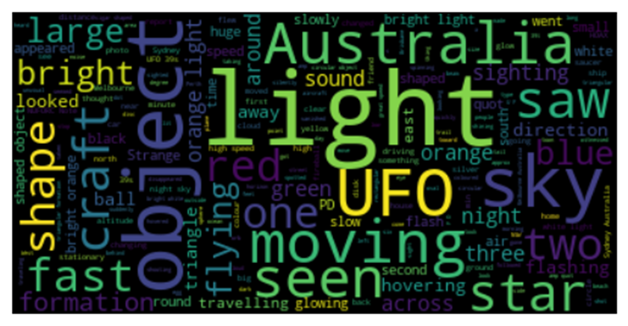

Word cloud

Slide 10

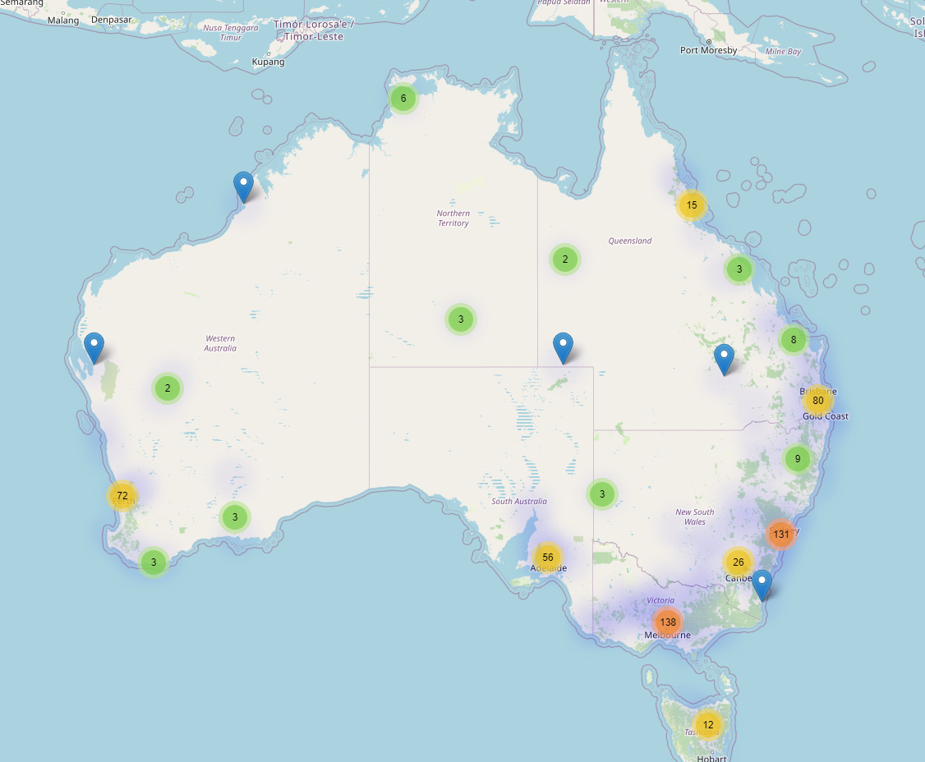
UFO sightings across Australia

Slide 11
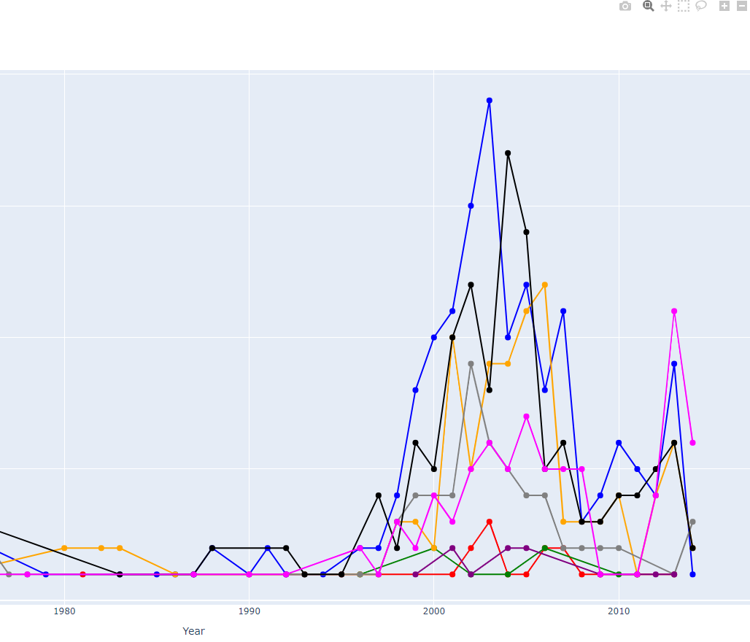
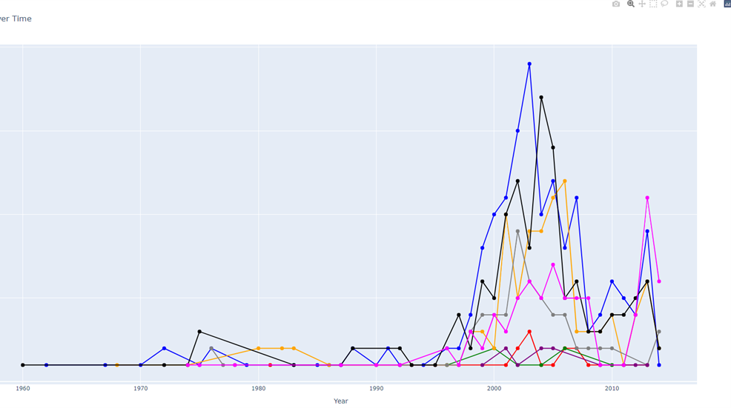
Total UFO Sightings by State Over Time

Slide 12
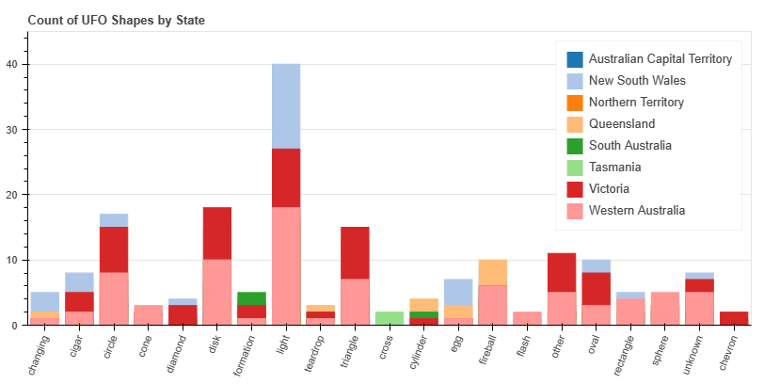
UFO Shapes by State

Slide 13
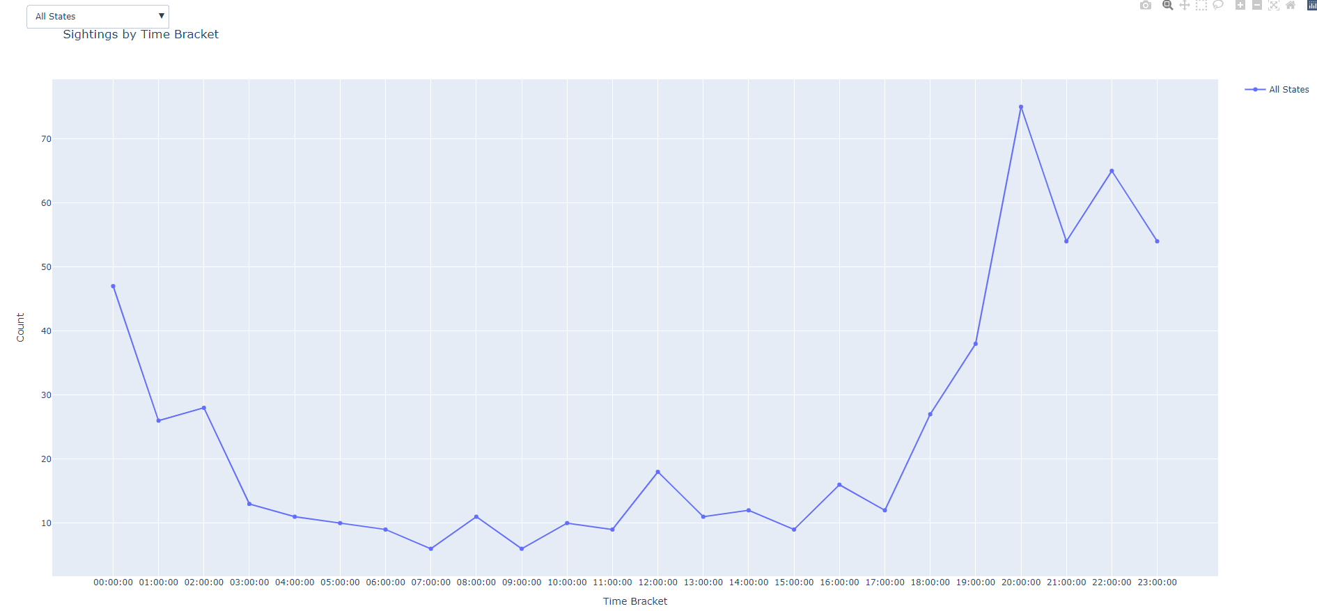
Sightings by Time Bracket

Slide 14
Dashboard page
https://Hluu1.github.io/Group-Project-3

